Slide 1
Stage 3: Artist
Clipshrine.com
What do you remember from the last class?
What was your favorite part?

Slide 2
Objectives
Students will:
Count the number of times an action should be repeated and represent it as a loop
Divide the number of degrees in a circle into even segments
Calculate the angles in equilateral and 30 60 90 triangles
Given a perimeter and one side of a rectangle, calculate the remaining sides
Identify symmetrical shapes
Decompose a shape into its smallest repeatable sequence

Slide 3
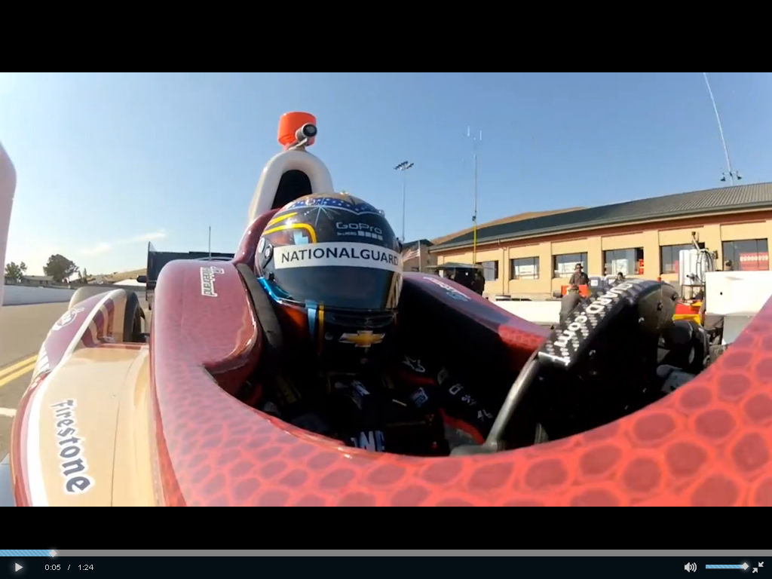
Video
www.studio.code.org/s/course3/stage/3/puzzle/1

Slide 4
Example #1
The triangle is an equilateral triangle. All sides have 60 degrees between them. Your goal is to complete the triangle with the artist.
2 lines are already drawn.
Draw the 3rd line.
Notes:
If the artist moves forward which way will he go? He’ll go over the bottom line again.
How far does the artist need to move? 200 pixels
Which way should the artist turn before he moves? left

Slide 5
Example ( more challenging)
Some of the code is already here.
What needs to be added to create the design?
Notes:
penColor(color_random()); moveForward(100); moveBackward(100); turnRight(45);

Slide 6
Directions
Complete the sequence
Progress at the sequence of Stage 3: Artist

